Slide 1





A Data-Driven Analysis of Workers’ Earnings on Amazon Mechanical Turk
Kotaro Hara, Abigail Adams, Kristy Milland, Saiph Savage Chris Callison-Burch, Jeffrey P. Bigham
Kotaro Hara
Abigail Adams
Kristy Milland
Saiph Savage
Chris Callison-Burch
Jeffrey P. Bigham

Slide 2

600k
online workers and counting
The Hamilton Project (2015)
Notes:
A gig economy is transforming the way we work. In 2015, 600k people worked online and this number is increasing.
-- Note
WorldBank estimates that about 4.8 million active workers contributed to online crowdsourcing
-- Figure
Saeful Muslim, https://thenounproject.com/search/?q=male%20female&i=1258540

Slide 3

Online outsourcing industry generated
$2b
Hitlin (2016), WorldBank (2015)
Notes:
In 2013, online gig-economy, or crowdsourcing, generated two billion dollars. The economic significance of crowdsourcing is rising.
-- Figures
Figure created by Kirby Wu from the Noun Project

Slide 4
Are workers treated fairly? How does this new work style affect their lives?
!
Notes:
But at the same time, a number of researchers raised concerns about whether workers are treated fairly.

Slide 5
Martin et al. 2014; Berg 2016; Irani and Silberman 2016; Alkhatib et al. 2017
Notes:
The issue has been discussed in CHI as well as else where.

Slide 6
Workers earn a fraction of the U.S. minimum wage ($7.25/h)
$7.25/h
$5/h [Hitlin 2015]
$4.65/h [Berg 2016]
$1/h [Martin et al. 2015]
$0/h
Notes:
Particularly, they repeatedly point out that workers only earn a fraction of the U.S. minimum wage, which is $7.25/h. This is problematic given that 75% Mechanical Turk workers live in the U.S. and income generation is their primary goal

Slide 7
These figures are subjective data based on workers’ opinions on an online forum and survey responses
The lack of reward and task duration data has prevented us from objectively analysing workers’ hourly wage
$7.25/h
$5/h [Hitlin 2015]
$4.65/h [Berg 2016]
$1/h [Martin et al. 2015]
$0/h
Notes:
However, these figures from previous work have been calculated based on subjective data, which could be biased. The problem is that the lack of a large dataset of reward and task duration has prevented us from objectively analyzing workers’ hourly wage.

Slide 8

3.8m
task records
https://crowd-workers.com/
Notes:
To address this, we used the data collected through a Chrome plug-in called Crowd Workers. We collected 3.8 million task records from people who had this plug-in installed.

Slide 9
Research Questions
How much are workers earning on Amazon Mechanical Turk?
What contributes to the low wage?
Do demographics affect earnings?
Notes:
This data allows us to ask and quantitatively analyze two important questions “How much are workers earning on Amazon Mechanical Turk” and “What contributes to the low hourly wage.”
-- Figures
Figure created by Kirby Wu from the Noun Project

Slide 10
Research Questions
How much are workers earning on Amazon Mechanical Turk?
What contributes to the low wage?
Do demographics affect earnings?
Notes:
Let me start with the first research question.
-- Figures
Figure created by Kirby Wu from the Noun Project

Slide 11
Data
N=2,676 workers
Task description
title, keywords, description, task IDs, requester IDs, reward ($)
Task status
submitted vs. returned
Timestamps (task start, task end, task return)
Notes:
The data that we collected includes task description like title, keywords, description, task IDs, requester IDs, and reward, as well as task status like submitted vs returned and timestamps of task start, task end, task return.

Slide 12
Data
N=2,676 workers
Task description
title, keywords, description, task IDs, requester IDs, reward ($)
Task status
submitted vs. returned
Timestamps (task start, task end, task return)
These pieces of information enable us to calculate hourly wage
Notes:
Most important pieces of information are reward and timestamps, which allow us to calculate hourly wage.

Slide 13






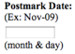

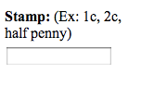

Slide 14


Postmark City:
Barre
Postmark State:
MA
Postmark Date:
Oct-11
Postmark Year:
1886
Stamp:
1c
$
0.
01

Slide 15
Even with this data, it is surprisingly hard to get an accurate estimation of hourly wage
Notes:
Let me describe how we calculated hourly wage using these pieces of information. But we found that it is surprisingly hard to get accurate estimation of hourly wage even with our data.
-- Figures
Royyan Wijaya

Slide 16
Hourly Wage Estimation (Naïve)
Task Start
Task End
Task Interval
Task Reward ($)
= Per-task Hourly Wage
Task Interval
Notes:
Probably the most naive way to calculate hourly wage is to measure the time it took to perform a task, and divide the reward by the task interval. This gives a per-task hourly wage.

Slide 17
Hourly Wage Estimation (Naïve)
Σ Task Reward ($)
= Per-worker Hourly Wage
Σ Task Interval
Worker
Naïve method of calculating hourly wage
Notes:
If we are interested in per-worker hourly wage, we can divide the total reward that a worker earned by total task interval. We call these naïve methods of calculating hourly wage

Slide 18
Hourly Wage Estimation (Naïve)
Σ Task Reward ($)
The naïve method is prone to both under- or over-estimate the hourly wage
= Per-worker Hourly Wage
Σ Task Interval
Worker
Naïve method of calculating hourly wage
Notes:
But using the naïve method may over- or under-estimate the hourly wage.

Slide 19
Wage Under-estimation
Interval₁
Interval₂
Worker
People can work on tasks concurrently
Notes:
Consider this case. A worker worked on a task, spending time interval 1. The worker worked on another task spending time interval 2. As illustrated here, people could, and indeed they do work on tasks concurrently.

Slide 20
Wage Under-estimation
Interval₁
Interval₂
Worker
Interval_{batch}
Interval_{batch} < Interval₁ + Interval₂
Notes:
Which makes the batched time interval smaller than the sum of interval 1 and interval 2.

Slide 21
Wage Under-estimation
This may cause naïve method to over-estimate work durations due to interval overlaps and under-estimate the hourly wage
Interval₁
Interval₂
Worker
Interval_{batch}
Interval_{batch} < Interval₁ + Interval₂
Notes:
This may cause naïve method to over-estimate work durations and under-estimate the hourly wage.

Slide 22
Wage Over-estimation
Interval₁
Interval₂
There could be a short gap between two tasks (e.g., time to search for a task)
Notes:
Let’s consider another case. A worker works on a task and spend interval 1. After a short gap, he or she works on another task.

Slide 23
Wage Over-estimation
Interval₁
Interval₂
Interval_{batch}
Interval_{batch} > Interval₁ + Interval₂
Notes:
This time, the batched interval is larger than the sum of interval 1 and interval 2.

Slide 24
Wage Over-estimation
The naïve method may under-estimate a work interval due to time between tasks and over-estimate the hourly wage
Interval₁
Interval₂
Interval_{batch}
Interval_{batch} > Interval₁ + Interval₂
Notes:
As a result, the naïve method may under-estimate a work interval due to time between task and over-estimate the hourly wage

Slide 25
Interval overlap
Time between tasks
Wage over- and under-estimation may affect the accuracy of hourly wage calculation
To reduce the effects of interval overlaps and time between tasks, we used a temporal clustering method to compute hourly wage
Notes:
Wage over- and under-estimation may affect the accuracy of hourly wage calculation. To reduce the effects of interval overlaps and time between tasks, we used a temporal clustering method

Slide 26
Temporal Clustering
Task 1
Task 2
Task 3
Task 4
Notes:
Let me explain this. Let’s look at an example. Say, a worker worked on Task 1, Task 2, Task 3, and Task 4.

Slide 27
Temporal Clustering
Task 1
Task 2
Task 3
Task 4
We want to cluster temporally close tasks together to ignore this small gap
Notes:
We want to cluster temporally close tasks together to ignore this small gap.

Slide 28
Temporal Clustering
Task 1
Task 2
Task 3
Task 4
While keeping this isolated task disjoint
Notes:
While keeping this isolated task disjoint.

Slide 29
Temporal Clustering
Task 1
Task 2
Task 3
Task 4
d₁
d₂
Notes:
To do this, we focus on distances between segments

Slide 30
Temporal Clustering
Task 1
Task 2
Task 3
D
Task 4
D
If d_{k} is smaller than D,
d₁
d₂
Notes:
We introduce a constant capital D. If a distance is smaller than this constant capital D, then…

Slide 31
Temporal Clustering
Task 1
Task 2
Task 3
D
Task 4
D
If d_{k} is smaller than D, we group the time intervals together,
d₁
d₂
Notes:
We group the time intervals together

Slide 32
Temporal Clustering
Task 1
Task 2
Task 3
D
Task 4
D
If d_{k} is smaller than D, we group the time intervals together, and otherwise keep them disjoint
d₁
d₂
Notes:
Otherwise, keep them disjoint

Slide 33
Temporal Clustering: Cluster-based Hourly Wage
Task 1
Task 2
Task 3
Task 4
T_{cluster}
Notes:
Now we can use the cluster interval…

Slide 34
Temporal Clustering: Cluster-based Hourly Wage
Task 1
$₁
Task 2
$₂
Task 3
$₃
Task 4
T_{cluster}
Notes:
And a cluster reward, which is a sum of all the rewards from the tasks in the cluster

Slide 35
Temporal Clustering: Cluster-based Hourly Wage
Task 1
$₁
Task 2
$₂
Task 3
$₃
Task 4
T_{cluster}
Notes:
And a cluster reward, which is a sum of all the rewards from the tasks in the cluster

Slide 36
Temporal Clustering: Cluster-based Hourly Wage
Task 1
$_{cluster}
Task 2
Task 3
Task 4
T_{cluster}
We define per-cluster hourly wage as $_{cluster} / T_{cluster}
Notes:
To calculate per-cluster hourly wage

Slide 37
Temporal Clustering: Cluster-based Hourly Wage
Σ Cluster Reward ($)
Per-worker Hourly Wage with Clustering
=
Σ Cluster Interval
Worker
Because different choice of D yield different sets of clusters, we use D=0 and D=1 minute and see their effects on cluster-based hourly wages
Notes:
And if we are interested in per-worker hourly wage based on the clustering method, we can sum up cluster rewards and divide it by total cluster interval. Because different choice of the capital D yield different sets of clusters, we used D=0 and D=1

Slide 38
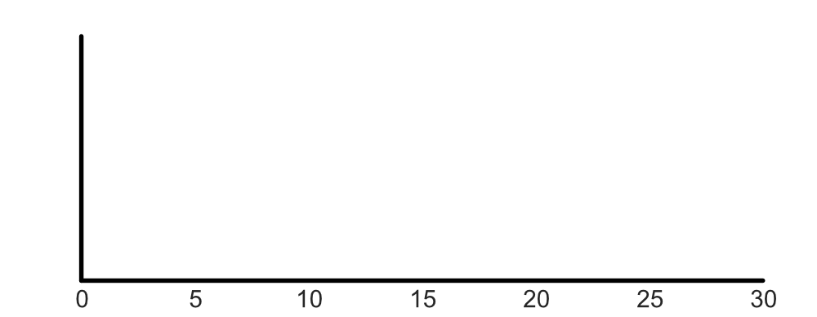
Worker Hourly Wage: Result (Naïve)
Density
Per-worker Hourly Wage ($/h)
Notes:
Let me show you the hourly wage distribution, calculated by using both naïve method and cluster-based method. Here, x-axis is per-worker hourly wage and y-axis is a density.

Slide 39
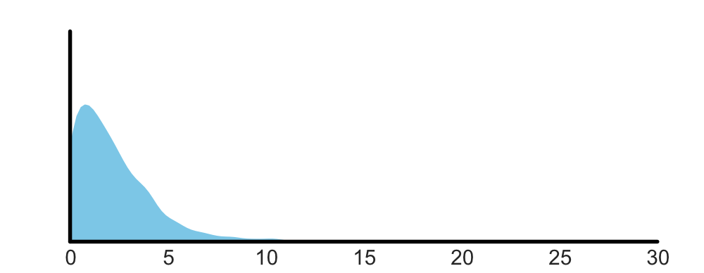
Worker Hourly Wage: Result (Naïve)
Density
Naïve
Per-worker Hourly Wage ($/h)
Notes:
Here is the distribution of hourly wage calculated by the naive method

Slide 40

Worker Hourly Wage: Result (Naïve)
Median hourly wage = $1.77/h
Density
Naïve
Per-worker Hourly Wage ($/h)
Notes:
The median hourly wage is $1.77/h

Slide 41

Worker Hourly Wage: Result (Clustered)
The wage distribution becomes more flat (median = $2.11/h).
Density
Naïve
D=0
Per-worker Hourly Wage ($/h)
Notes:
Let’s compare this to the distribution of the hourly wage with the D0 clustering. As you can see, the distribution becomes slightly more flat as a result of reducing the effect of interval overlap. The median hourly wage is pushed up to $2.11.

Slide 42

Worker Hourly Wage: Result (Clustered)
The D=1 wage distribution is more flat compared to the naïve distribution but peakier compared to D=0. D=1 median is $1.99/h
Density
Naïve
D=0
D=1
Per-worker Hourly Wage ($/h)
Notes:
The hourly wage distribution calculated by cluster-based method with D=1 minute is more flat compared to the naïve distribution but peakier compared to the D=0 distribution. This is because we take into account of gaps between tasks. Median hourly wage is 1.99.

Slide 43
Worker Hourly Wage: Result
Median worker hourly wage is around $2/h. Naïve estimation method under-estimates the hourly wage by approximately 12% (compared to D=1).
Density
Naïve
D=0
D=1
Per-worker Hourly Wage ($/h)
Notes:
What you can take from this analysis is that the median worker hourly wage is around $2/h regardless of the method. Although the naïve estimation method under-estimates the hourly wage by 12%, it is not too off.

Slide 44
Takeaway 1
The majority of workers on Amazon Mechanical Turk work with hourly wage below $2/h

Slide 45
Research Questions
How much are workers earning on Amazon Mechanical Turk?
What contributes to the low wage?
Do demographics affect earnings?
Notes:
-- Figures
Figure created by Kirby Wu from the Noun Project

Slide 46
Research Questions
How much are workers earning on Amazon Mechanical Turk?
What contributes to the low wage?
Do demographics affect earnings?
Notes:
Now we know that the workers are under-paid, let me explain why they are earning so little.
-- Figures
Figure created by Kirby Wu from the Noun Project

Slide 47

What contributes to the low wage?
$
¢
Unpaid work
Low reward
Requesters
Qualifications
Task types
Notes:
In this paper, we explored a variety of factors that may affect the hourly wage, including the effects of unpaid work, low task reward, presence of unfair requesters, qualifications, and work types.
-- Image
Creative Stall from Noun Project

Slide 48
What contributes to the low wage?
$
¢
Unpaid work
Low reward
Requesters
Qualifications
Task types
Notes:
But in this presentation, I will only discuss about the effects of unpaid work and requesters.
-- Image
Creative Stall from Noun Project

Slide 49
What contributes to the low wage?
$
¢
Unpaid work
Low reward
Requesters
Qualifications
Task types
Notes:
We’ll start with the unpaid work.
-- Image
Creative Stall from Noun Project

Slide 50
“
[…] aspects of turking [(working on Amazon Mechanical Turk)] like simply searching for jobs can take a considerable amount time.
The time spent learning and searching are clear examples of invisible [(unpaid)] work that Turkers must engage in […].
”
Martin et al., (2014) Being a Turker, CSCW 2014
Notes:
Let me quote the prior work to explain what I mean by unpaid work.

Slide 51
The issue of unpaid work has been identified in prior work, but its effects are not quantified
Notes:
The issue of unpaid work was previously pointed out, but its effects are not quantified.

Slide 52
We quantify three types of unpaid work
Reject
Returned
Time spent on returned tasks
Time spent on rejected tasks
Time between tasks
Notes:
In this paper, we quantified three types of unpaid work: time spent on returned tasks, time spent on rejected tasks, and time between tasks

Slide 53
We quantify three types of unpaid work
Reject
Returned
Time spent on returned tasks
Time spent on rejected tasks
Time between tasks
Notes:
Let me start with the returned tasks.

Slide 54
Task Submit and Return
Submit
Worker
Notes:
When a worker works on a task, two things could happen. He or she could complete the task and submit it.

Slide 55
Task Submit and Return
Reward will not be paid and so the time spent is wasted
Returned
Worker
Notes:
Or, if for some reason they cannot finish it, they will return the task. In this case, reward will not be paid.

Slide 56
Time Spent on Returned Tasks
Submitted
Returned
Σ
Σ
Returned
Time_{submitted}
Time_{returned}
For all tasks from all workers
Notes:
To understand the impact of returned tasks, we calculated the total time spent on submitted tasks and returned tasks.

Slide 57
Time Spent on Returned Tasks: Result
Submitted
Returned
Σ
Σ
Returned
Time_{submitted}
Time_{returned}
= 98,202 hours (68.2%)
= 45,778 hours (31.8%)
Notes:
We observed that about 98k hours were spent on the submitted tasks and 46k hours were spent on returned tasks. This means that 31.8% of time is wasted due to task return.

Slide 58
We quantify three types of unpaid work
Reject
Returned
Time spent on returned tasks
Time spent on rejected tasks
Time between tasks
Notes:
Moving on to rejected tasks.

Slide 59
Task Accept and Reject
Accept
Worker
Notes:
Once a worker submits a task, two things can happen. First, a requester agrees to pay the reward.

Slide 60
Task Accept and Reject
Reject
Worker
Notes:
Or the requester reject the task and refuses to pay the reward.

Slide 61
Time Spent on Rejected Tasks
We had data on task accept vs. reject status for 29.6% of the submitted tasks
Accepted
Rejected
Accept
Reject
Σ
Σ
Time_{accepted}
Time_{rejected}
Notes:
We had data on task accept vs. reject for 29.6% of the submitted task records. Using this data, we again calculated the time spent on the accepted tasks and rejected tasks.

Slide 62
Time Spent on Rejected Tasks: Result
We had data on task accept vs. reject status for 29.6% of the submitted tasks
Accepted
Rejected
Accept
Reject
Σ
Σ
Time_{accepted}
Time_{rejected}
= 33,130 hours (99.3%)
= 240 hours (0.7%)
Notes:
We observed that 33k hours were spent on the accepted tasks, and 240 hours were spent on the rejected tasks.

Slide 63
We quantify three types of unpaid work
Reject
Returned
Time spent on returned tasks
Time spent on rejected tasks
Time between tasks
Notes:
Finally, let’s look at time between the tasks.

Slide 64
Time Between Tasks
Worker
We want to know the effect of this small gap between tasks (e.g., task search time)
Notes:
We wanted to know how much time was wasted because of this gap between tasks.

Slide 65
Time Between Tasks
Clustering (D=1min)
Worker
Clustering (D=0min)
Σ
Δ
Notes:
To do this, we compare the difference in clustered task intervals. We cluster tasks using D=1 min and D=0. By subtracting the time, we get the difference in the interval, delta. We sum up all the delta to see the total time between the tasks.

Slide 66
Time Between Tasks: Result
Clustering (D=1min)
Worker
Clustering (D=0min)
Σ
= 4,603 hours
Δ

Slide 67
Result
45,778 hours
31.8% of work
240 hours
0.7% of work
4,603 hours
4.7% of work
Reject
Returned
Notes:
This is the overall result.

Slide 68
Takeaway 2
Returning tasks has the biggest impact on the hourly wage. In fact, 31.8% of work time is wasted due to this unpaid work.

Slide 69
What contributes to the low wage?
$
¢
Unpaid work
Low reward
Requesters
Qualifications
Task types
Notes:
Now, we investigate the requesters payment behaviors.
-- Image
Creative Stall from Noun Project

Slide 70
What contributes to the low wage?
$
¢
Unpaid work
Low reward
Requesters
Qualifications
Task types
Notes:
Now, we investigate the requesters payment behaviors.
-- Image
Creative Stall from Noun Project

Slide 71
Workers are underpaid. Is this because all requesters treat workers unfairly, or are there are small number of people who request very low paid tasks?
< $2/h
Notes:
We saw that the majority of workers are underpaid. It is not clear if this is because a few people are underpaying or all the requesters are underpaying.

Slide 72
Workers are underpaid. Is this because all requesters treat workers unfairly, or are there are small number of people who request very low paid tasks?
< $2/h
Notes:
We already saw that the majority of workers are underpaid. It is not clear if this is because a few people are underpaying or all the requesters are underpaying.

Slide 73
Workers are underpaid. Is this because all requesters treat workers unfairly, or are there a small number of requesters who post many very low paid tasks?
< $2/h
Notes:
We already saw that the majority of workers are underpaid. It is not clear if this is because a few people are underpaying or all the requesters are underpaying.

Slide 74
We investigated the distribution of per-requester hourly payment
Notes:
We investigate the distribution of per-requester hourly payment.

Slide 75
Per-requester Hourly Payment
$
$
Requester
$
Σ
$
$
$
$
Workers
Notes:
Let’s see how we calculated the per-requester hourly payment. A requester requests tasks to be completed multiple workers. These workers work on multiple tasks.
--Image
Saeful Muslim

Slide 76
Per-requester Hourly Payment
$
$
Requester
$
Σ
$
$
$
$
Workers
Notes:
To calculate the per-requester hourly payment, we sum up task intervals and rewards.
--Image
Saeful Muslim

Slide 77
Per-requester Hourly Payment
Σ Task Payment ($)
Requester
Per-requester Hourly Payment
=
Σ Task Interval
Workers
Notes:
To calculate the per-requester hourly payment, we sum up task intervals and rewards. Then, we divide the total task payment by the total task interval to get per-requester hourly payment for this requester.
--Image
Saeful Muslim

Slide 78
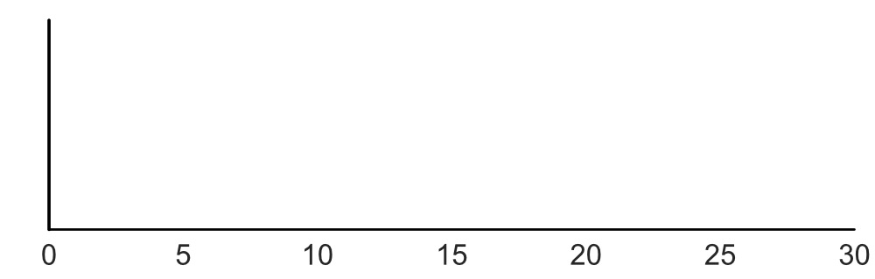
Per-requester Hourly Payment: Result
Density
Per-requester Hourly Payment ($/h)
N=19,598 requesters
Notes:
Let’s look at the distribution of the hourly payment. X-axis is per-requester hourly payment, and y-axis is density.

Slide 79
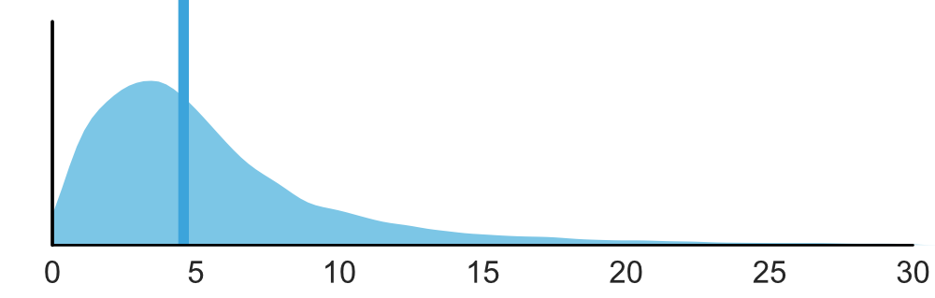
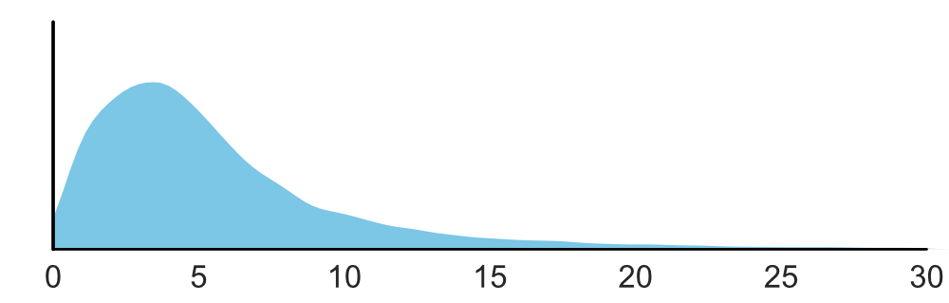
Per-requester Hourly Payment: Result
Median=$4.57/h
Density
Per-requester Hourly Payment ($/h)
N=19,598 requesters
Notes:
Here is the distribution of the per-requester hourly payment. The median payment is $4.57/h.

Slide 80
Takeaway 3
About half of the requesters pay below $5/h, which is below the U.S. federal minimum wage.
Notes:
Unfortunately, about half of the requesters pay below $5/h, which is below the U.S. federal minimum wage.

Slide 81
Research Questions
How much are workers earning on Amazon Mechanical Turk?
What contributes to the low wage?
Do demographics affect earnings?
Notes:
Now we know that the workers are under-paid, let me explain why they are earning so little.
-- Figures
Figure created by Kirby Wu from the Noun Project

Slide 82
Research Questions
How much are workers earning on Amazon Mechanical Turk?
What contributes to the low wage?
Do demographics affect earnings?
Notes:
Now we know that the workers are under-paid, let me explain why they are earning so little.
-- Figures
Figure created by Kirby Wu from the Noun Project

Slide 83


Worker Demographics and Earnings on Amazon Mechanical Turk:
An Exploratory Analysis, Kotaro Hara, Abigail Adams, Kristy Milland, Saiph Savage, Benjamin V. Hanrahan, Chris Callison-Burch, Jeffrey P. Bigham
Kotaro Hara
Abigail Adams
Kristy Milland
Saiph Savage
Ben Hanrahan
Chris Callison-Burch
Jeffrey P. Bigham

Slide 84
Research questions
Our prior work estimated that workers on Amazon Mechanical Turk earn approximately $2/h. However, the lack of worker demographic information prevented us from asking questions like “is there an income gap between workers from different countries?” and “is there a difference in earnings between workers with and without disabilities?”

Slide 85
Demographic Survey
We gathered demographic information of N=1,238 crowd workers who previously used the Crowd Workers plugin via an online survey posted on Amazon Mechanical Turk. The survey asked the country of residence, gender, disability/health condition. We combined this with the data gathers from the Crowd Workers plugin to calculate median hourly wage of each survey respondent.

Slide 86
Respondents
US: 815, India: 298, Other: 125
Notes:
Because 90% of workers who responded to our survey are from the U.S. (N=815) or India (N=298), we focus on and contrast the hourly wages of workers from these two countries. The median hourly wages of the workers from the U.S. and India were $3.01/h and $1.41/h, respectively. The data shows that the U.S. workers earn significantly more than those in India. This result aligns with prior work by Martin et al., in which the authors suggested that the workers in the U.S. earn more than those in India [8]. Nevertheless, even the U.S. workers who earn more are underpaid compared to the federal minimum wage ($7.25/h).
India Flag by Xinh Studio from the Noun Project
usa flag by corpus delicti from the Noun Project

Slide 87
Earnings by Country
Notes:
Because 90% of workers who responded to our survey are from the U.S. (N=815) or India (N=298), we focus on and contrast the hourly wages of workers from these two countries. The median hourly wages of the workers from the U.S. and India were $3.01/h and $1.41/h, respectively. The data shows that the U.S. workers earn significantly more than those in India. This result aligns with prior work by Martin et al., in which the authors suggested that the workers in the U.S. earn more than those in India [8]. Nevertheless, even the U.S. workers who earn more are underpaid compared to the federal minimum wage ($7.25/h).

Slide 88
Respondents
622 female
616 male
Notes:
Prior work suggested that gender affects income on crowdsourcing marketplaces [1]. We investigated the wage gap between female and male workers to reinforce this finding. In addition to splitting the wage data only by gender (i.e., female vs. male), we also stratified the data with two layers: country of residence and gender. When the data was split solely based on gender, the median wage of female workers and male workers were $2.58/h and $2.30/h respectively, showing that the difference is marginal.
When the data was stratified using workers’ country of residence and gender, however, we observed that male workers earn more than female workers (Table 2). The median wage of the female workers in the U.S. is $2.79/h and the median wage of the male workers in the U.S. is $3.68/h. The median wage of the female workers in India is $1.37/h and the median wage of the male workers in the India is $1.43/h. The results suggest that both male and female workers in the U.S. earn more than the workers in India, but the wage gap is larger in the U.S.
Male and Female by Milinda Courey from the Noun Project

Slide 89
Earnings by Gender
Notes:
US female: 2.79
US male: 3.68
India female: 1.37
India male: 1.43

Slide 90
Earnings by Gender (USA)
Notes:
US female: 2.79
US male: 3.68
India female: 1.37
India male: 1.43
Prior work suggested that gender affects income on crowdsourcing marketplaces [1]. We investigated the wage gap between female and male workers to reinforce this finding. In addition to splitting the wage data only by gender (i.e., female vs. male), we also stratified the data with two layers: country of residence and gender. When the data was split solely based on gender, the median wage of female workers and male workers were $2.58/h and $2.30/h respectively, showing that the difference is marginal.
When the data was stratified using workers’ country of residence and gender, however, we observed that male workers earn more than female workers (Table 2). The median wage of the female workers in the U.S. is $2.79/h and the median wage of the male workers in the U.S. is $3.68/h. The median wage of the female workers in India is $1.37/h and the median wage of the male workers in the India is $1.43/h. The results suggest that both male and female workers in the U.S. earn more than the workers in India, but the wage gap is larger in the U.S.

Slide 91
Earnings by Gender (India)
Notes:
US female: 2.79
US male: 3.68
India female: 1.37
India male: 1.43
Prior work suggested that gender affects income on crowdsourcing marketplaces [1]. We investigated the wage gap between female and male workers to reinforce this finding. In addition to splitting the wage data only by gender (i.e., female vs. male), we also stratified the data with two layers: country of residence and gender. When the data was split solely based on gender, the median wage of female workers and male workers were $2.58/h and $2.30/h respectively, showing that the difference is marginal.
When the data was stratified using workers’ country of residence and gender, however, we observed that male workers earn more than female workers (Table 2). The median wage of the female workers in the U.S. is $2.79/h and the median wage of the male workers in the U.S. is $3.68/h. The median wage of the female workers in India is $1.37/h and the median wage of the male workers in the India is $1.43/h. The results suggest that both male and female workers in the U.S. earn more than the workers in India, but the wage gap is larger in the U.S.

Slide 92
Respondents
270 with disabilities or health conditions affecting work
Notes:
Disability and Health Condition
Researchers claimed that online work environment could be a good alternative to contemporary office work environment [4,9]. For example, people who have challenges in commuting to distant office space could benefit from at-home work. We investigate the wage of people with and without disabilities to study if there is wage gap due to disabilities. The median hourly wage of people without disability and with disability or health problem are $2.50/h and $2.47/h respectively, showing only marginal difference in hourly wage.
When we stratify the data using both country of residence and disability and health problem, we observed that people without disabilities or health problems earned slightly more than the other group. In the U.S., median wage of people with and without disability or health problem were $2.80/h and $3.14/h, respectively. Likewise, the wage were $1.26/h and $1.43/h in India. This shows that people without disabilities or health conditions earn slightly more on AMT in terms of hourly wage. However, the gap seems to be smaller compared to the wage gap due to gender difference, particularly in the U.S.
Blind by corpus delicti from the Noun Project
By OCHA Visual, US
In the OCHA Humanitarian Icons v.02 Collection

Slide 93
Disability or Worker Health Problem
Notes:
US health problem: 2.80
US no health problem: 3.14
India health problem: 1.26
India no health problem: 1.43
Researchers claimed that online work environment could be a good alternative to contemporary office work environment [4,9]. For example, people who have challenges in commuting to distant office space could benefit from at-home work. We investigate the wage of people with and without disabilities to study if there is wage gap due to disabilities. The median hourly wage of people without disability and with disability or health problem are $2.50/h and $2.47/h respectively, showing only marginal difference in hourly wage.
When we stratify the data using both country of residence and disability and health problem, we observed that people without disabilities or health problems earned slightly more than the other group. In the U.S., median wage of people with and without disability or health problem were $2.80/h and $3.14/h, respectively. Likewise, the wage were $1.26/h and $1.43/h in India. This shows that people without disabilities or health conditions earn slightly more on AMT in terms of hourly wage. However, the gap seems to be smaller compared to the wage gap due to gender difference, particularly in the U.S.

Slide 94
Disability or Health Problem (USA)
Notes:
US health problem: 2.80
US no health problem: 3.14
India health problem: 1.26
India no health problem: 1.43
Researchers claimed that online work environment could be a good alternative to contemporary office work environment [4,9]. For example, people who have challenges in commuting to distant office space could benefit from at-home work. We investigate the wage of people with and without disabilities to study if there is wage gap due to disabilities. The median hourly wage of people without disability and with disability or health problem are $2.50/h and $2.47/h respectively, showing only marginal difference in hourly wage.
When we stratify the data using both country of residence and disability and health problem, we observed that people without disabilities or health problems earned slightly more than the other group. In the U.S., median wage of people with and without disability or health problem were $2.80/h and $3.14/h, respectively. Likewise, the wage were $1.26/h and $1.43/h in India. This shows that people without disabilities or health conditions earn slightly more on AMT in terms of hourly wage. However, the gap seems to be smaller compared to the wage gap due to gender difference, particularly in the U.S.

Slide 95
Disability or Health Problem (India)
Notes:
US health problem: 2.80
US no health problem: 3.14
India health problem: 1.26
India no health problem: 1.43
Researchers claimed that online work environment could be a good alternative to contemporary office work environment [4,9]. For example, people who have challenges in commuting to distant office space could benefit from at-home work. We investigate the wage of people with and without disabilities to study if there is wage gap due to disabilities. The median hourly wage of people without disability and with disability or health problem are $2.50/h and $2.47/h respectively, showing only marginal difference in hourly wage.
When we stratify the data using both country of residence and disability and health problem, we observed that people without disabilities or health problems earned slightly more than the other group. In the U.S., median wage of people with and without disability or health problem were $2.80/h and $3.14/h, respectively. Likewise, the wage were $1.26/h and $1.43/h in India. This shows that people without disabilities or health conditions earn slightly more on AMT in terms of hourly wage. However, the gap seems to be smaller compared to the wage gap due to gender difference, particularly in the U.S.

Slide 96
Takeaway 4
Women make less money than men, India-based workers make less than US-based workers, workers with health problems make less than workers without health problems.
Notes:
Unfortunately, about half of the requesters pay below $5/h, which is below the U.S. federal minimum wage.

Slide 97
The Gender Wage Gap in an Online Labour Market: The Cost of Interruptions
Abigail Adams-Prassl, Kotaro Hara, Kristy Milland, Saiph Savage, Chris Callison-Burch, Jeffrey P. Bigham
Kotaro Hara
Abigail Adams
Kristy Milland
Saiph Savage
Chris Callison-Burch
Jeffrey P. Bigham
Notes:
This paper analyses gender differences in working patterns and wages on Amazon Mechanical Turk. Using information on 2 million tasks, we find no gender difference in task selection nor experience on the platform. Nonetheless, women earn 20% less per hour on average. Half of this gap is explained by differences in the scheduling of work; women have more fragmented work patterns with consequences for their task completion speed. A follow up survey shows that the wage gap is concentrated amongst women with young children, who also report that domestic responsibilities affect their ability to plan and complete work online.

Slide 98
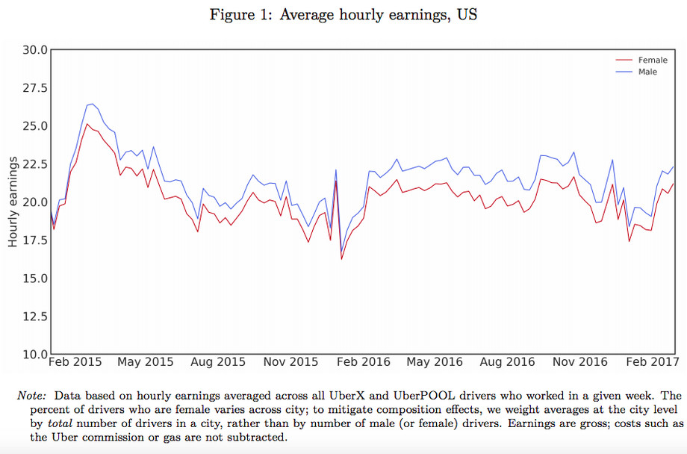

Notes:
Men who drive for Uber earn roughly 7 percent more per hour than women, according to a new study that examined over a million Uber drivers. Women were found to earn $1.24 per hour less than men, and also $130 less per week on average, in part because they tend to drive fewer hours.
“Overall, our results suggest that, even in the gender-blind, transactional, flexible environment of the gig economy, gender-based preferences (especially the value of time not spent at paid work and, for drivers, preferences for driving speed) can open gender earnings gaps,” the study concludes.
https://www.theverge.com/2018/2/6/16980072/uber-driver-gender-earnings-gap-study

Slide 99
Mturk Earnings by Gender (USA)
Notes:
US female: 2.79
US male: 3.68
India female: 1.37
India male: 1.43
Prior work suggested that gender affects income on crowdsourcing marketplaces [1]. We investigated the wage gap between female and male workers to reinforce this finding. In addition to splitting the wage data only by gender (i.e., female vs. male), we also stratified the data with two layers: country of residence and gender. When the data was split solely based on gender, the median wage of female workers and male workers were $2.58/h and $2.30/h respectively, showing that the difference is marginal.
When the data was stratified using workers’ country of residence and gender, however, we observed that male workers earn more than female workers (Table 2). The median wage of the female workers in the U.S. is $2.79/h and the median wage of the male workers in the U.S. is $3.68/h. The median wage of the female workers in India is $1.37/h and the median wage of the male workers in the India is $1.43/h. The results suggest that both male and female workers in the U.S. earn more than the workers in India, but the wage gap is larger in the U.S.

Slide 100
Why do women earn less than men?
Is there discrimination in the platform?
No, MTurk is gender blind.
Do women have less experience on MTurk?
No.
Do women select different tasks than men?
No.
Notes:
women earn 20% less per hour on average
There is a growing body of literature documenting gender differences in pay and work in “gender blind”
workplaces. Even in the face of identical remuneration and promotion structures, men and women make
different choices over when, where, and how much to work away from home.
For example, when offered the same rota and remuneration opportuni
irst, the need to take time out to “fire fight”12 urgent domestic tasks might result in longer intervals between completed tasks and, potentially, a more
ties, Bolotnyy and Emanuel (2018) find that women select lower paying work schedules to avoid work times when children are more likely to be at home and they are less likely to accept better remunerated overtime when it is offered at last minute.

Slide 101
Why do women earn less than men?
Women earn 20% less per hour on average. Half of this gap is explained by differences in the scheduling of work.
Women have more fragmented work patterns with consequences for their task completion speed.
Notes:
There is a growing body of literature documenting gender differences in pay and work in “gender blind”
workplaces. Even in the face of identical remuneration and promotion structures, men and women make
different choices over when, where, and how much to work away from home.
For example, when offered the same rota and remuneration opportuni
irst, the need to take time out to “fire fight”12 urgent domestic tasks might result in longer intervals between completed tasks and, potentially, a more
ties, Bolotnyy and Emanuel (2018) find that women select lower paying work schedules to avoid work times when children are more likely to be at home and they are less likely to accept better remunerated overtime when it is offered at last minute.

Slide 102
Mothers versus others?
The wage gap is concentrated amongst women with young children, who also report that domestic responsibilities affect their ability to plan and complete work online.
Notes:
There is a growing body of literature documenting gender differences in pay and work in “gender blind”
workplaces. Even in the face of identical remuneration and promotion structures, men and women make
different choices over when, where, and how much to work away from home.
For example, when offered the same rota and remuneration opportuni
First, the need to take time out to “fire fight”12 urgent domestic tasks might result in longer intervals between completed tasks and, potentially, a more
ties, Bolotnyy and Emanuel (2018) find that women select lower paying work schedules to avoid work times when children are more likely to be at home and they are less likely to accept better remunerated overtime when it is offered at last minute.

Slide 103
Takeaways
< $2/h
Crowd workers are underpaid and they often earn below $2/h
$
Unpaid work, particularly returning tasks has a large impact on the hourly wage
Majority of the requesters reward workers below $5/h

Slide 104
Takeaways
< $2/h
Crowd workers are underpaid and they often earn below $2/h
$
Unpaid work, particularly returning tasks has a large impact on the hourly wage
Majority of the requesters reward workers below $5/h
Women make less money than men even on online platforms

Slide 105
Discussion and Future Work
Could we create tools for workers to make it easier to search for tasks that give them good wage, avoid tasks that are not completable, and find requesters fair wage?
Could we create technologies for requesters to help them pay fairly?

Slide 106

Discussion and Future Work
How can we nudge more people to pledge and help them keep committing to their promises?

Slide 107
Limitations
Sampling bias
Our analyses did not take bonus payment into account
No information about demographics

Slide 108
A Data-Driven Analysis of Workers’ Earnings on Amazon Mechanical Turk
Kotaro Hara, Abigail Adams, Kristy Milland, Saiph Savage Chris Callison-Burch, Jeffrey P. Bigham
The Economic and Social Research Council, Grant ES/N017099/1
We thank the workers who provided the work log data that enabled this research
Image credits to Saeful Muslim, Kirby Wu from the Noun Project

Slide 109
A Data-Driven Analysis of Workers’ Earnings on Amazon Mechanical Turk
Kotaro Hara, Abigail Adams, Kristy Milland, Saiph Savage Chris Callison-Burch, Jeffrey P. Bigham
Kotaro Hara
Abigail Adams
Kristy Milland
Saiph Savage
Chris Callison-Burch
Jeffrey P. Bigham

